Slide 1

Deploying Online Shop (WordPress) with MySQL on AWS using Kubernetes
DEPI Project - DevOps Track
Presented by:
1. Abeer Mahrous: WordPress & Kubernetes.
2. Nayra Ahmed: WordPress & Kubernetes.
3. Mina Issac: infrastructure
4. Omar Ashraf: pipelines
5. Mahmoud Ashraf: Cloud.
6. Mohamed Mohamed : monitoring & virtualization.
Date: 11/30/2025

Slide 2



Project Overview & Objectives
Our objective is to deploy a scalable, highly available WordPress site with MySQL on AWS using Kubernetes.
Orchestration
Cloud Provider
Containerization
Kubernetes (K8s) for container management.
AWS (EKS, EBS, EFS, ELB) for infrastructure.
Docker for WordPress & MySQL images.
Goal: Achieve efficient resource utilization, automated scaling, and robust fault tolerance.

Slide 3
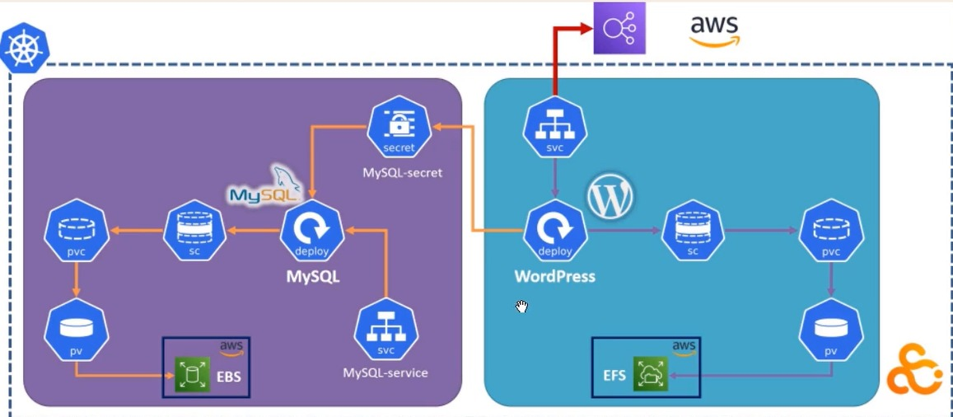
Architecture Diagram
Backend
Storage Strategy
Frontend
WordPress Pods (ReplicaSet) connected to a Load Balancer.
MySQL Pod connected to persistent storage.
AWS EFS: Shared storage for WordPress files (ReadWriteMany).
AWS EBS: Block storage for Database (ReadWriteOnce).

Slide 4
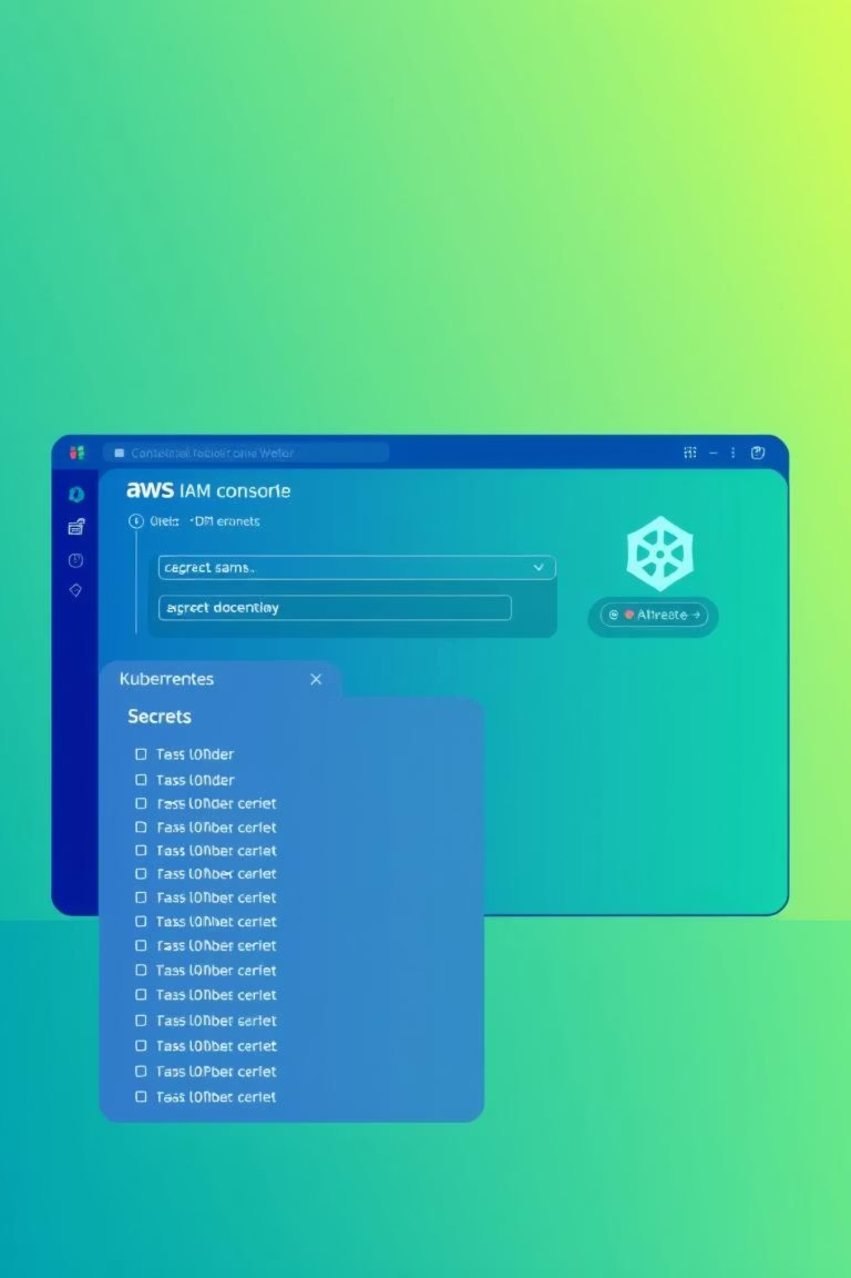



Prerequisites & IAM Configuration
AWS Setup
CSI Drivers
IAM Users and Policies created for EBS CSI Driver and EFS CSI Driver. OIDC provider configured for EKS.
Installed ebs.csi.aws.com for block storage and efs.csi.aws.com for file system management.
Security
Kubernetes Secrets (onlineshop-project) created for secure AWS Access Keys.

Slide 5

Database Layer (MySQL) Deployment
Security: Secret (mysql-pass) created to encode the root password.
Storage (The Challenge): Databases need low-latency, dedicated storage.
Solution: Used StorageClass (ebs-sc) with WaitForFirstConsumer binding mode.
PVC: Requesting 5Gi of ReadWriteOnce (RWO) storage.
Deployment: MySQL 5.6 container uses the mounted EBS volume at /var/lib/mysql.

Slide 6

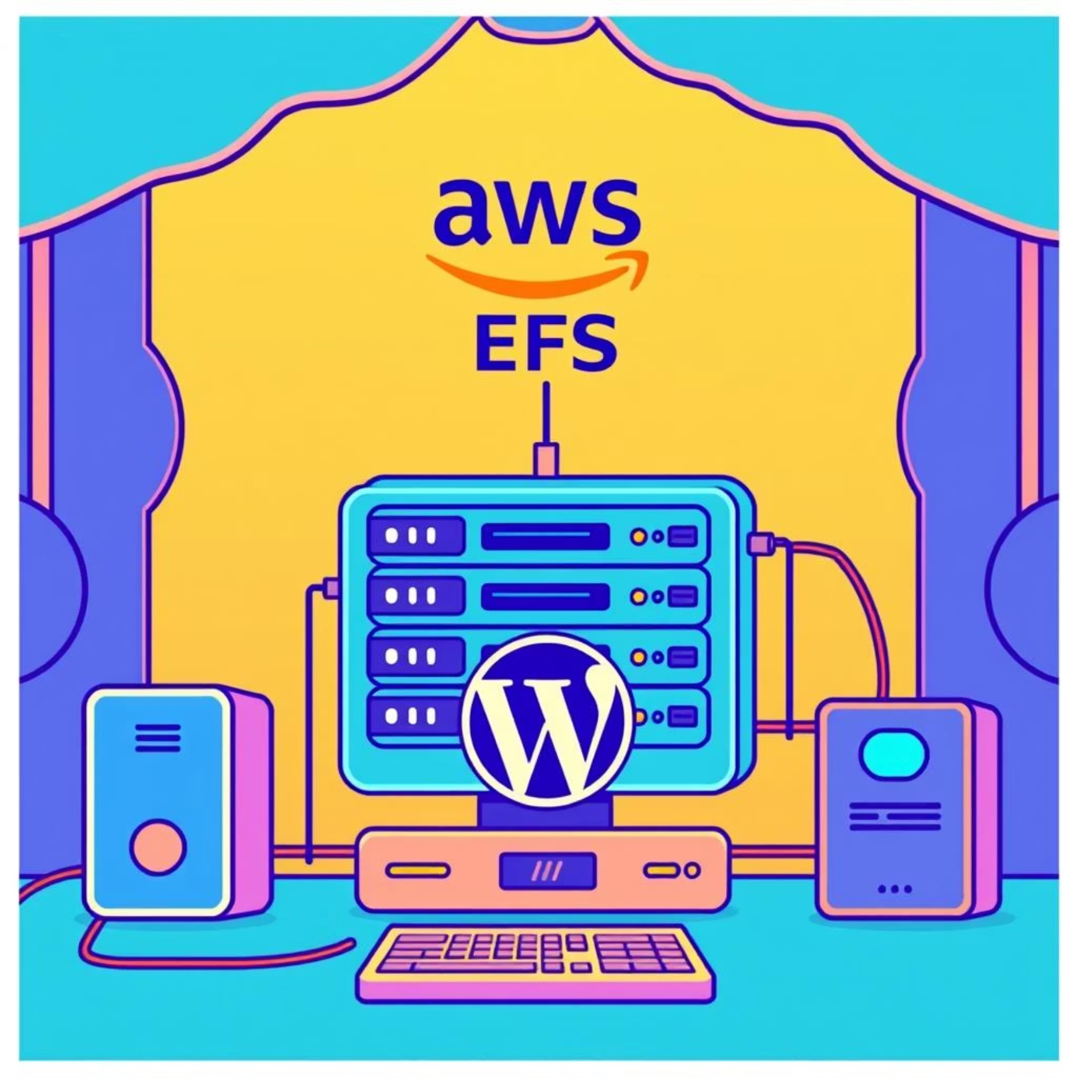
Frontend Layer (WordPress) Storage Strategy
The Problem
The Solution (AWS EFS)
WordPress needs to scale across multiple nodes. All pods must instantly see new plugins/images, but EBS cannot be mounted to multiple nodes simultaneously.
Created an EFS File System & Access Point on AWS. Configured StorageClass (efs-sc) and PersistentVolume (PV).
PVC: Requesting 5Gi of ReadWriteMany (RWX) storage. This allows all WordPress replicas to share /var/www/html.

Slide 7
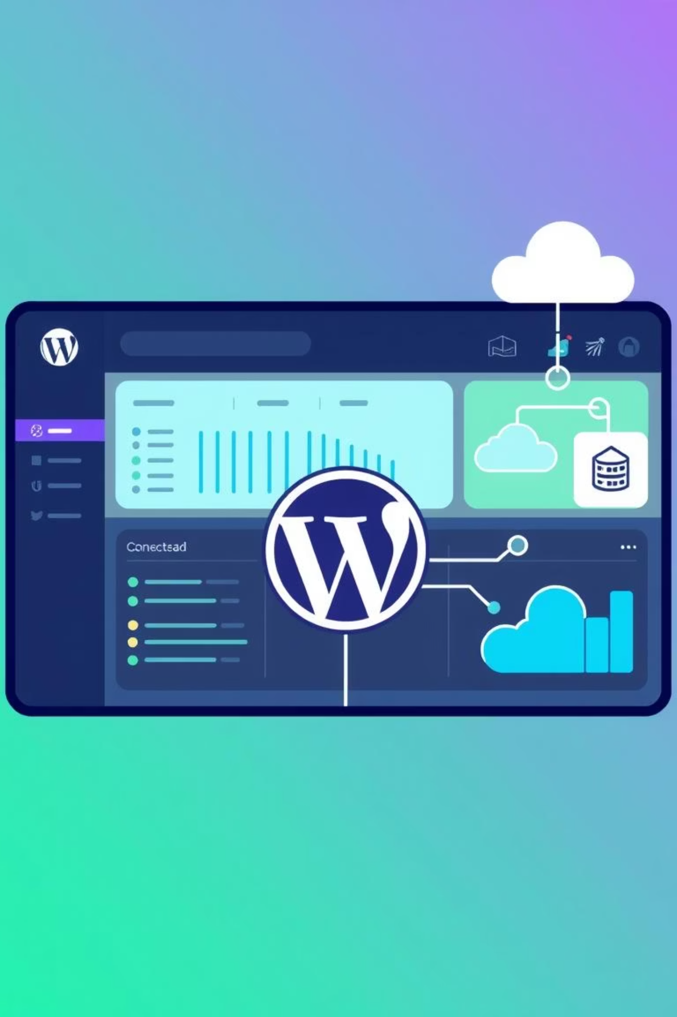
WordPress Application Deployment
Configuration
Environment Variables
Deployed wordpress:php7.1-apache image.
WORDPRESS_DB_HOST: Pointing to mysql-svc.
WORDPRESS_DB_PASSWORD: Pulled securely from K8s Secrets.
Volume Mount
Mounted the EFS PVC to /var/www/html for data persistence.

Slide 8

Scalability & High Availability
Self-Healing
Scaling
Executed: kubectl scale deploy wordpress --replicas=2. Kubernetes immediately spun up a second pod.
If a node fails, Kubernetes automatically reschedules the pod to a healthy node without data loss, maintaining continuous service.
kubectl get deploy showed 2/2
Ready. Both pods share the same EFS storage, ensuring instant visibility of user uploads.

Slide 9
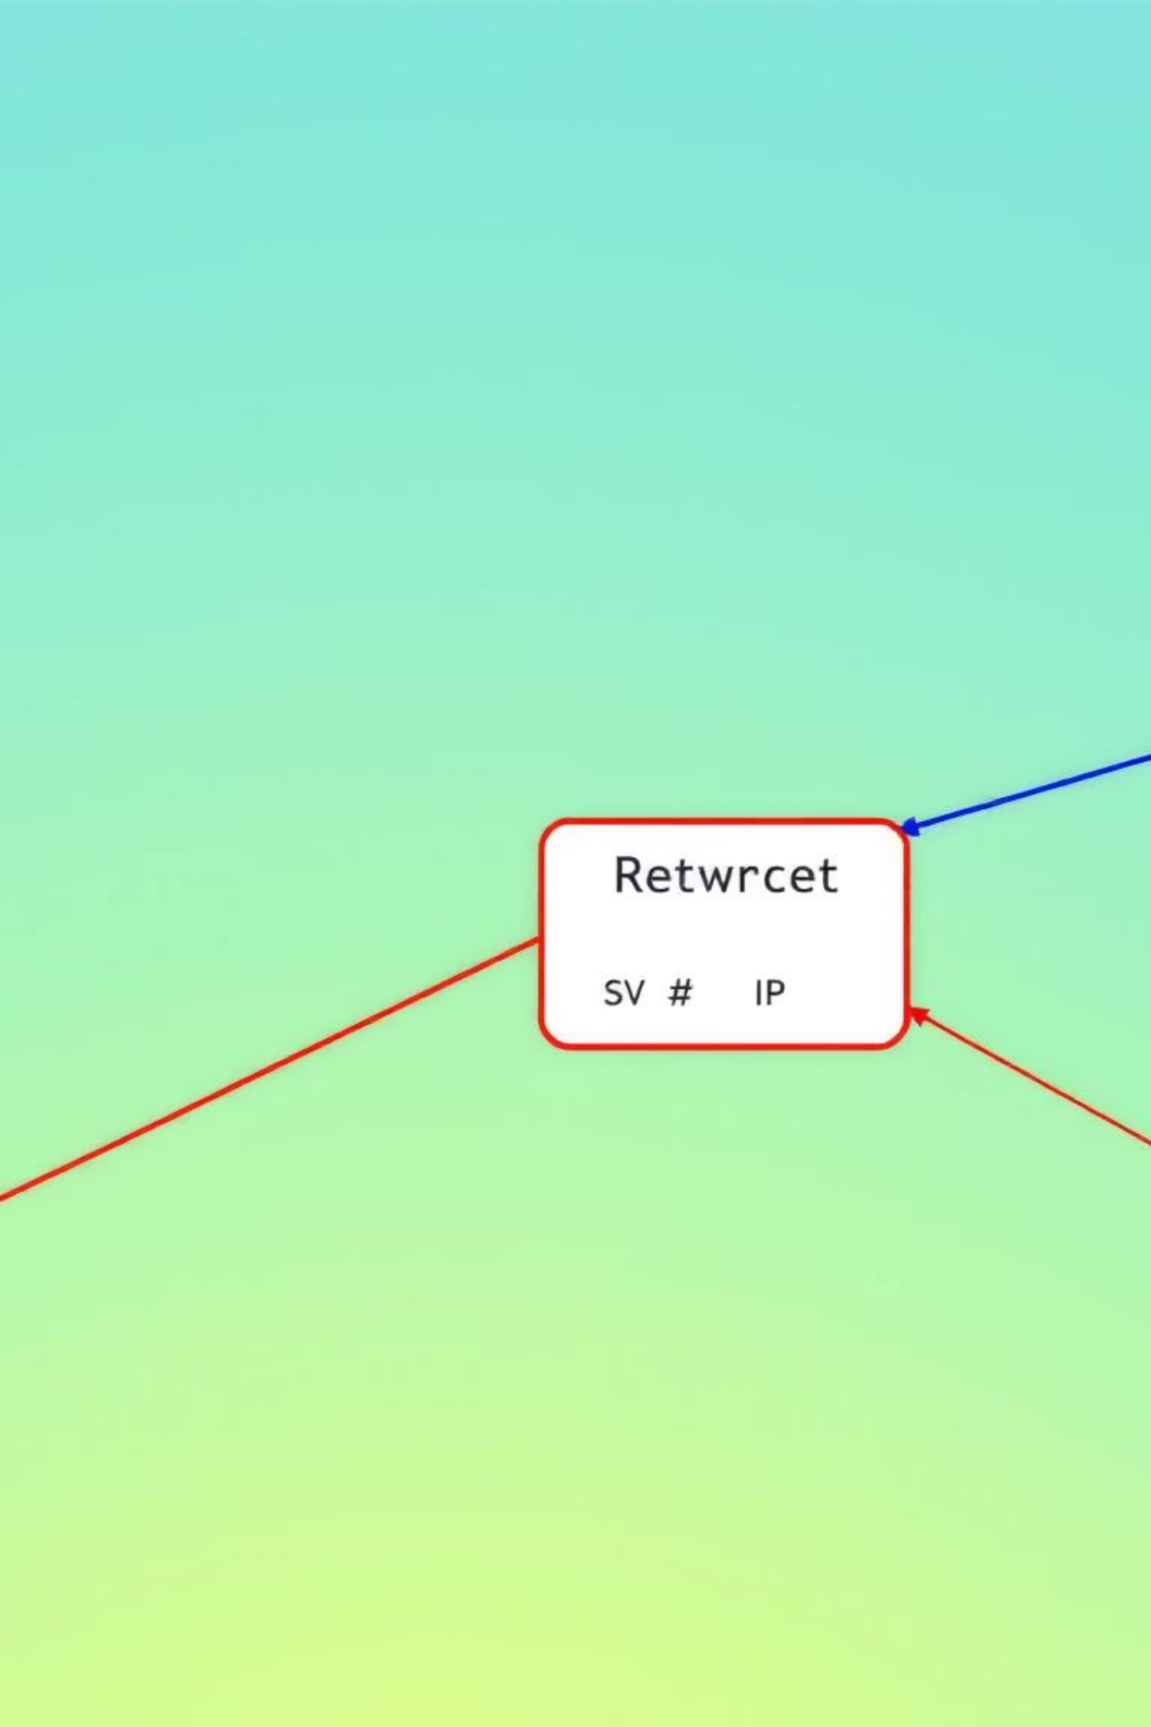



Networking & Exposure
MySQL Service
Type ClusterIP (Internal only) for enhanced security.
WordPress Service
Type LoadBalancer for external access.
External Access
AWS provisioned a Classic Load Balancer (ELB). Application accessible via External IP/DNS.

Slide 10

Conclusion & Future Work
Achievements
Future Enhancements
Deployed stateful application on EKS.
Implement HPA (Horizontal Pod Autoscaler).
Proper storage separation (EBS for DB, EFS for Files).
Integrate Route53 for custom domain.
Enable SSL/TLS with AWS Certificate Manager.
Achieved High Availability with multiple replicas.

